Slide 1
Ruby Training: Loops
Matthew Eakin, Manager
Managed Testing Practice
Sogeti, USA
Matthew.Eakin@us.sogeti.com

Slide 2
Agenda
Create the loops.rb file in any existing project
What is a loop?
Types of Loops
while
until
for
each
Using the “break” & “next” statement

Slide 3
What is a loop?
Definition: a loop is used to execute the same block of code a specified number of times
Ruby has numerous loop types it can use:
while
until

Slide 4
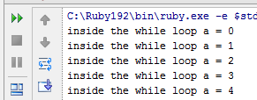
while
A “while” loop will execute a loop WHILE a condition is true
Syntax:
while conditional [do]
<code>
end
Write and Run this Code: Will get these results:
a = 0
num = 5
while a < num do
puts “inside the while loop a = #{a}”
a += 1
end

Slide 5
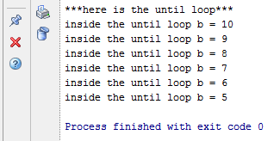
until
An “until” loop will execute a loop UNTIL a conditional is true
Syntax:
until conditional [do]
<code>
end
Write and Run this Code: Will get these results:
puts "***here is the until loop***"
b = 10
until b < num do
puts "inside the until loop b = #{b}"
b -= 1
end

Slide 6
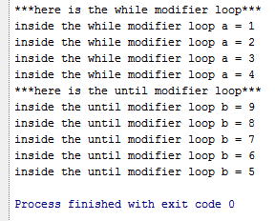
while and until loops as modifiers
Both the while and until loops can be written as modifiers
Syntax:
<action> while <condition>
<action> until <condition>
Write and Run this Code: Will get these results:
a = 0
puts "***here is the while modifier loop***"
puts "inside the while modifier loop a = #{a}" while (a += 1) < num
b = 10
puts "***here is the until modifier loop***"
puts "inside the until modifier loop b = #{b}" until (b -= 1) < num

Slide 7
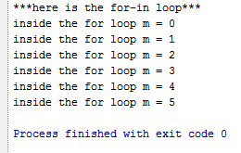
for/in
The “for” loop, or “for/in” loop, iterates through the elements of an enumerable object (such as an array). On each iteration, it assigns an element to a specified loop variable and then executes the body of the loop
Syntax:
For variable [, variable …] in collection [do]
<code, using variable>
end
Write and Run this Code: Will get these results:
for m in 0..5 do
puts “inside the for loop m = #{m}”
end

Slide 8
interators
Ruby contains methods called iterators which allow you to iterate (or loop) through an object. They are:
times – allows you to repeat code a specified number of times
5.times { |k| puts k}
each – used with arrays or hashes – allows you to step through each value in the array or hash
collection.each do |variable|
<code>
end

Slide 9
More interators
upto – allows you to start at a value and count up to a specified value
5.upto(10) do |u|
puts u
end
can also be written: 5.upto(10) { |u| puts u}
downto – the opposite of upto method, allows you to start at a value and count down to a specified value
10.downto (5) do |d|
puts d
end
Can also be written: 10.downto(5) { |d| puts d}

Slide 10
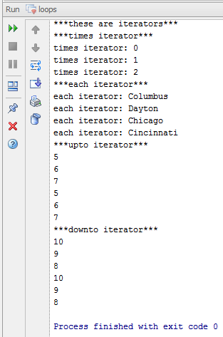
Coding interators
Write and Run this Code: Will get these results:
puts "***these are iterators***"
puts "***times iterator***"
3.times { |k| puts "times iterator: #{k}"}
puts "***each iterator***"
sogeti_cities = %w(Columbus Dayton Chicago Cincinnati)
sogeti_cities.each do |city|
puts "each iterator: #{city}"
end
puts "***upto iterator***"
5.upto(7) do |p|
puts p
end
5.upto(7) { |p| puts p}
puts "***downto iterator***"
10.downto(8) do |s|
puts s
end
10.downto(8) { |s| puts s}

Slide 11
Thank you

